Slide 1


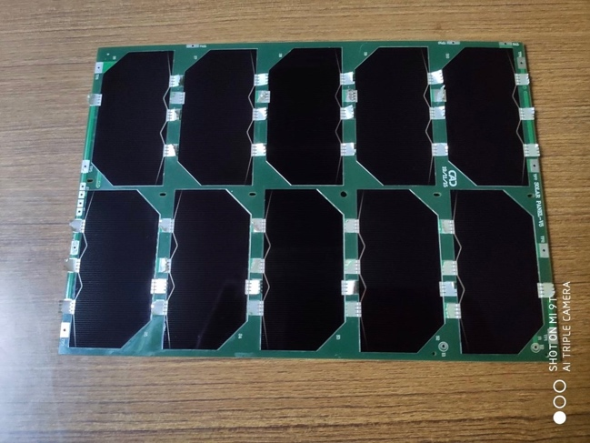
衛星
6G 通訊
電力
太空電力基板
高效光電晶片
人造衛星電力系統
具高純度低缺陷之特性
108 Lane 460, Nansi section 2, Zhongfeng Rd., Pingzhen, Taoyuan, 32472 Taiwan.

Slide 2
Single Crystal Growth
Czochralski Process as opposed to
Bridgeman process

Slide 3
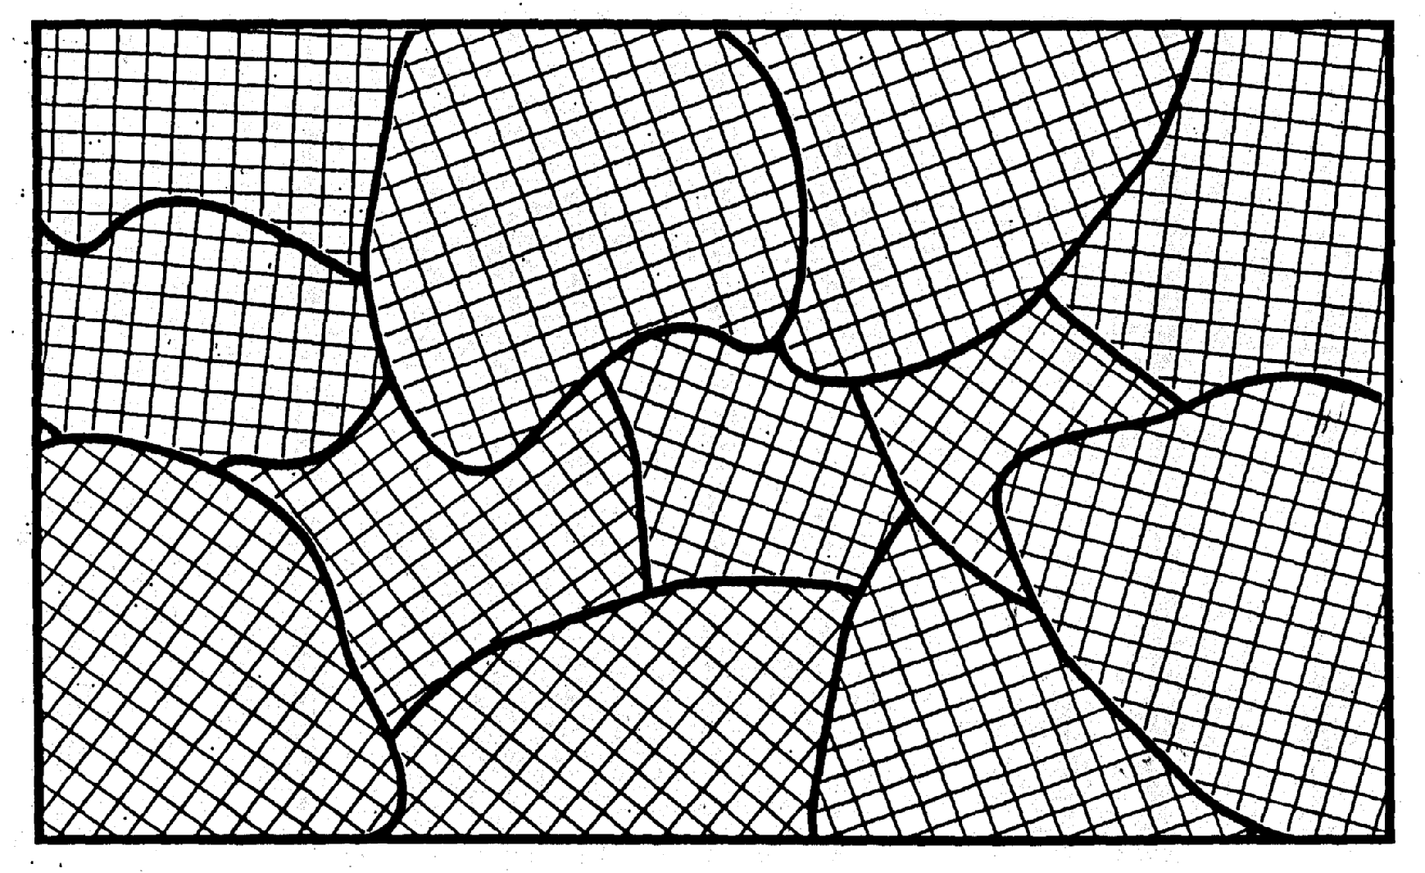
Grain Boundaries

Slide 4
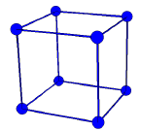
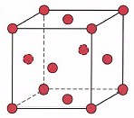
Types of unit cells
Simple cubic (SC)
Body-centered cubic (BCC)
Faced-centered cubic (FCC)

Slide 5
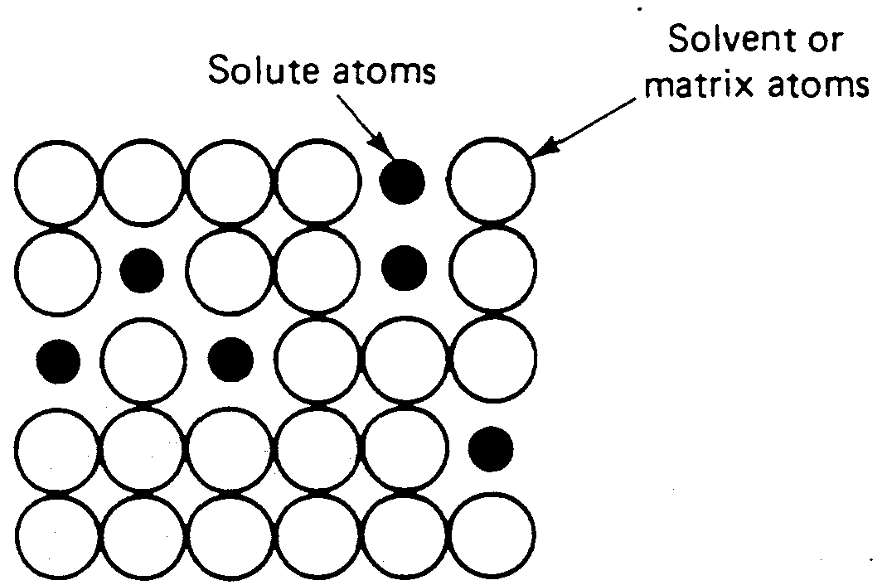
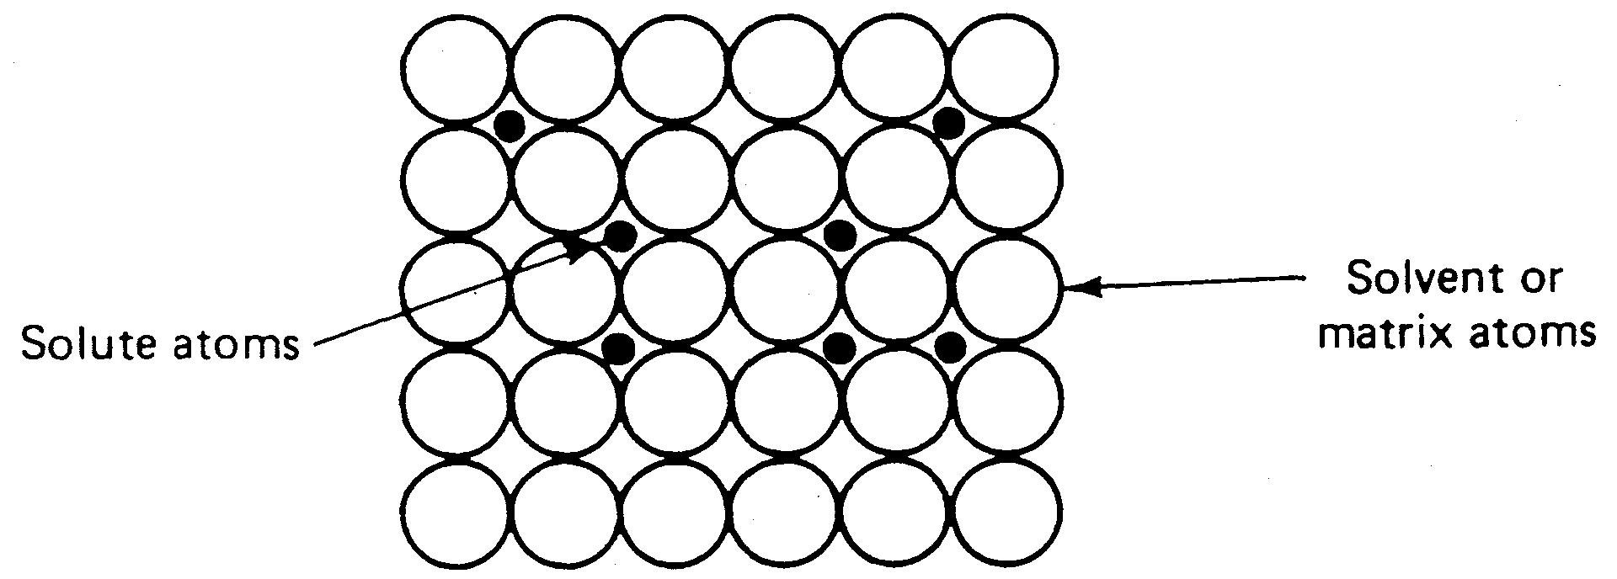
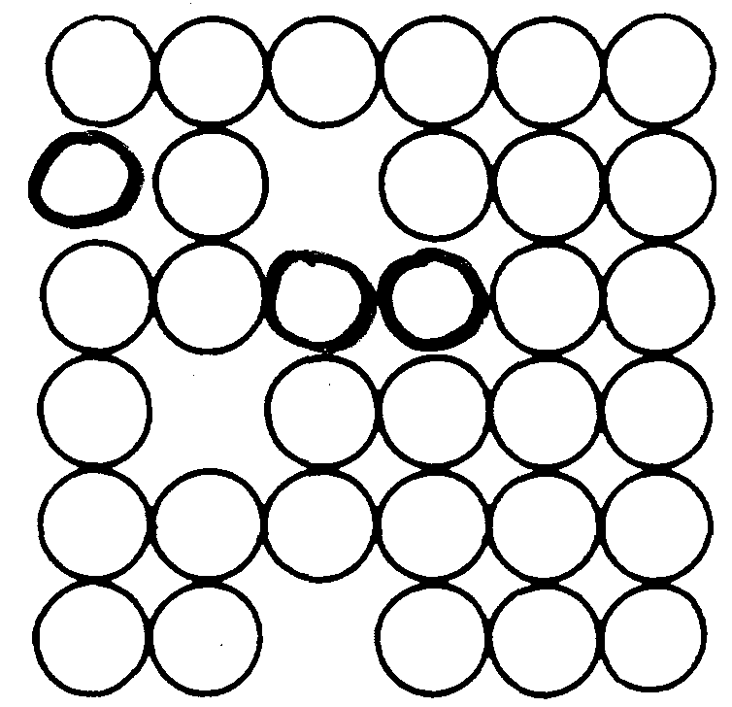
Point Defects
Substitutional
Interstitial
Vacancy

Slide 6
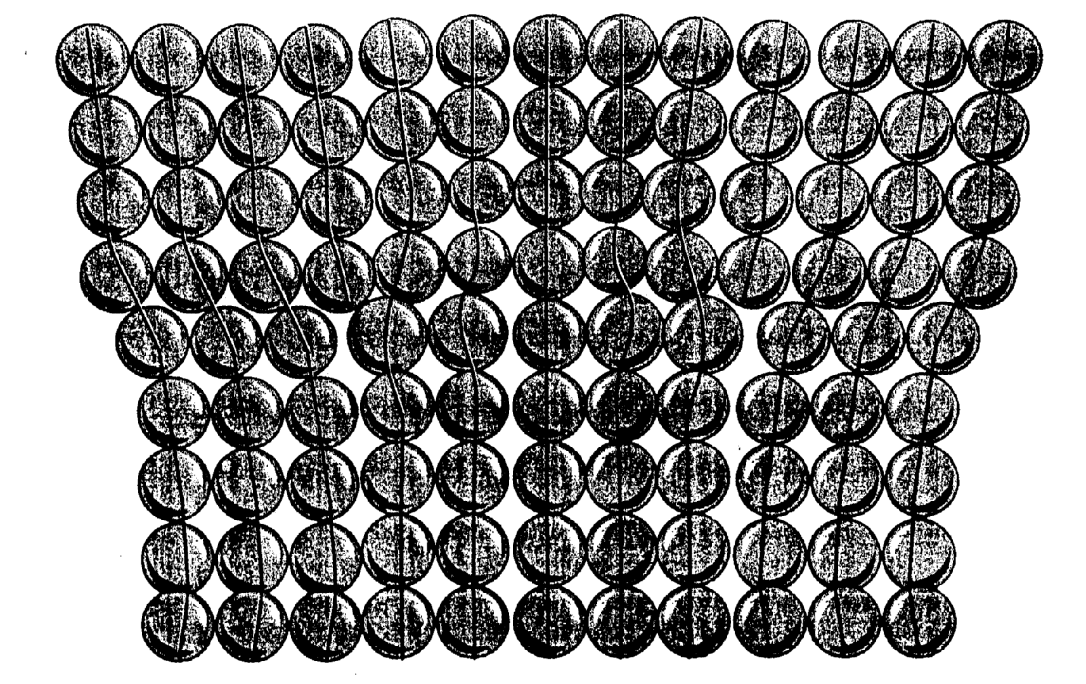
Line Defects - Dislocations

Slide 7
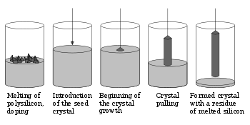
Czochralski Process

Slide 8
Czochralski Process
Pulling
Argon
Water
Cooling
Cold
Tm
Temperature
Temperature
Controller
Hot
PID
Heat
Graphite Heater

Slide 9
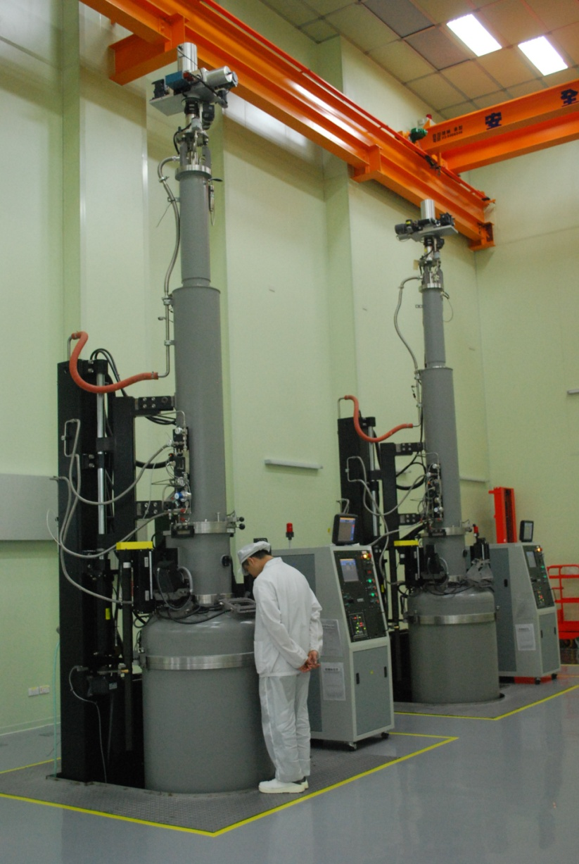
TaiCrystal Ingot Pullers

Slide 10
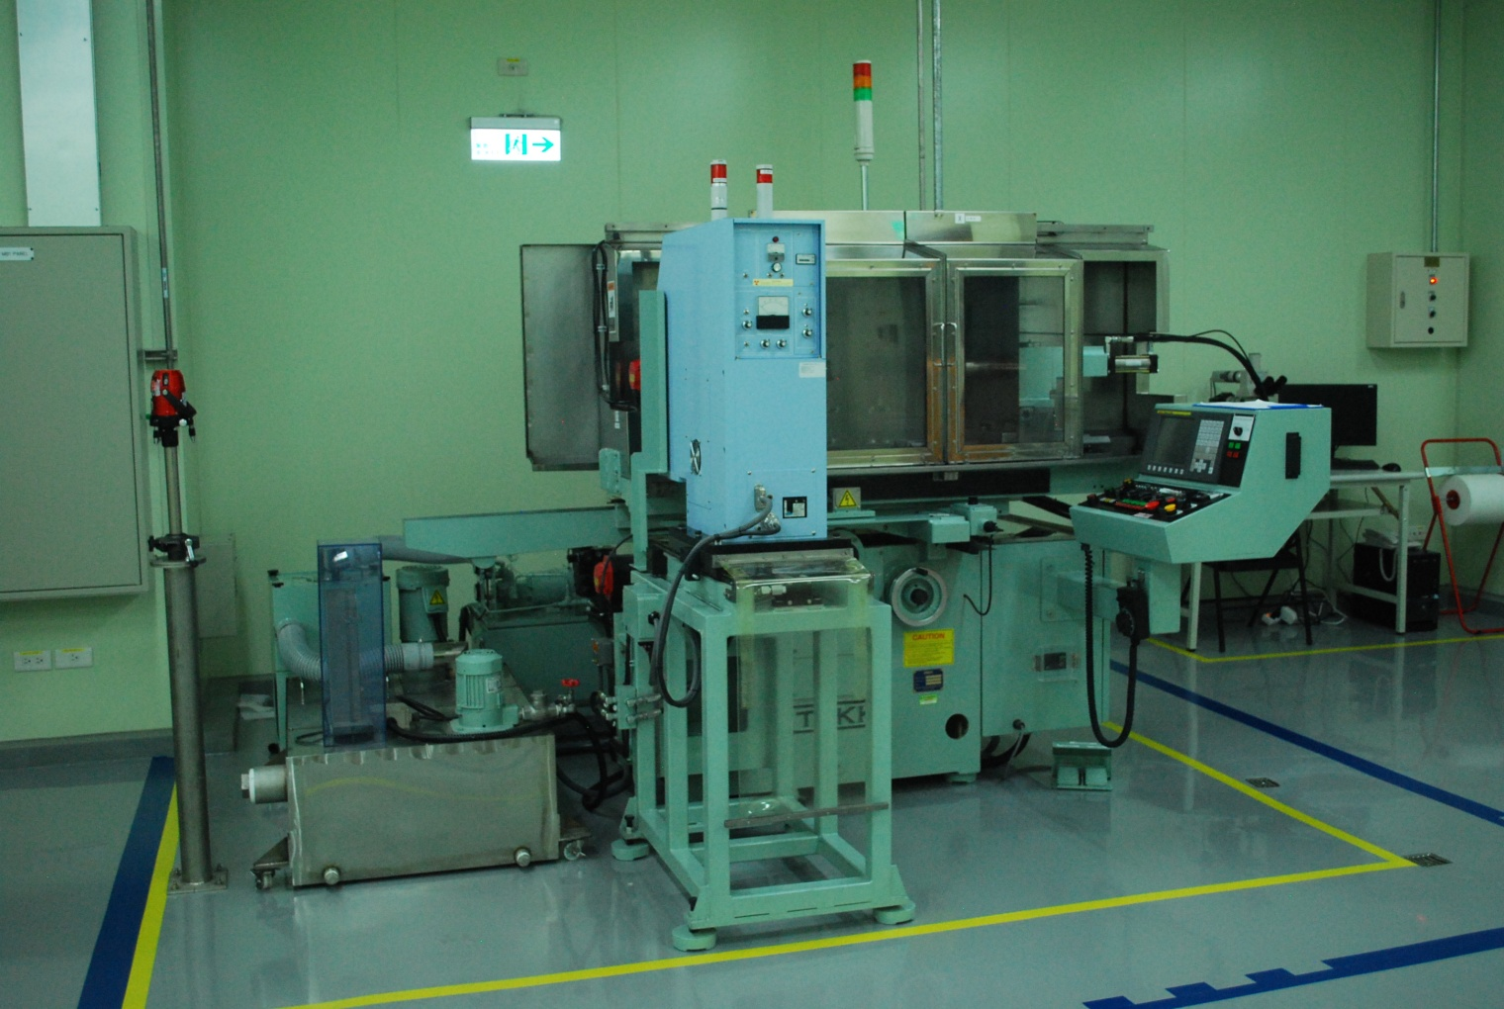
TaiCrystal Ingot Grinder

Slide 11
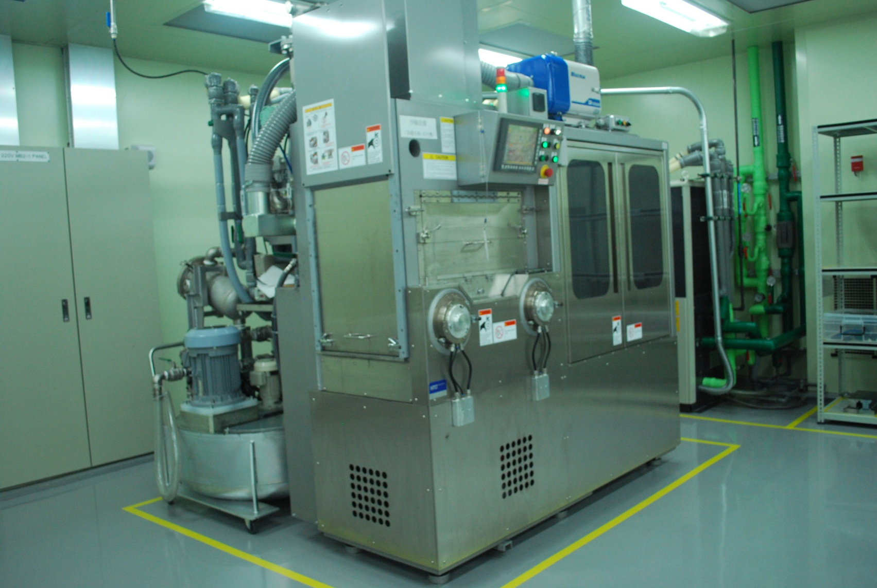
TaiCrystal Wafer Slicer

Slide 12
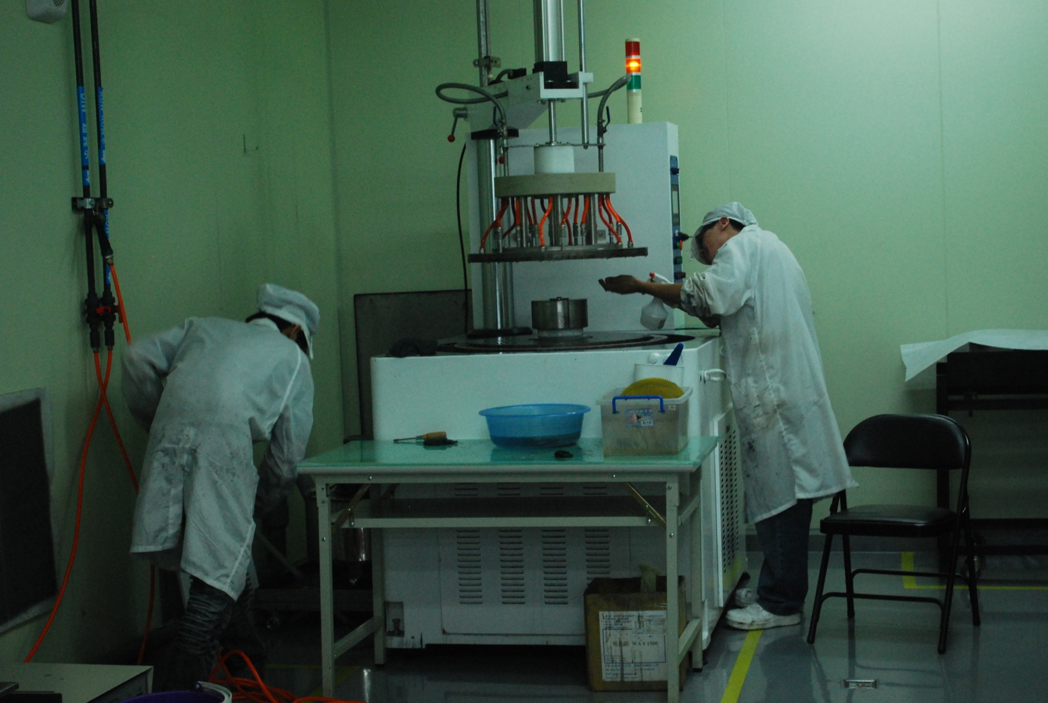
TaiCrystal Wafer Grinder

Slide 13
Germanium Single Crystal Ingots
Space Power Wafers
Space Solar Cells
Space Solar Modules
PV Systems
TaiCrystal International Products and Business

Slide 14
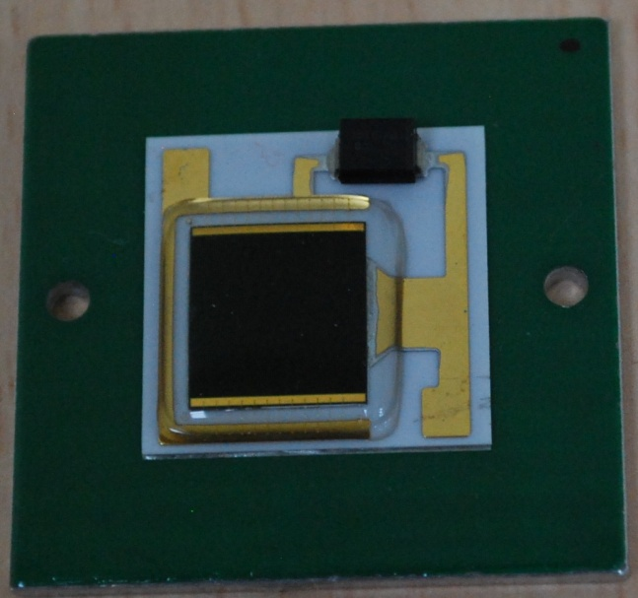
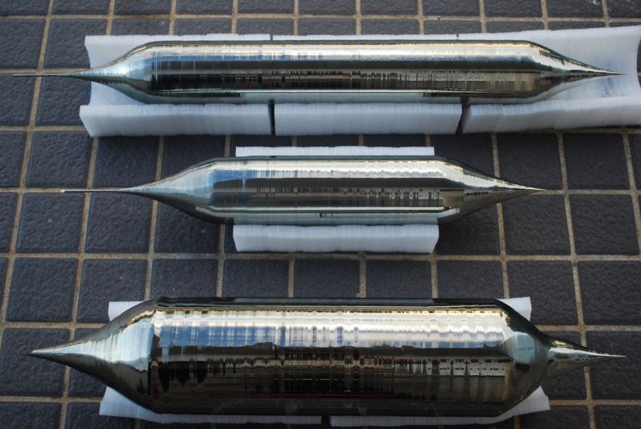
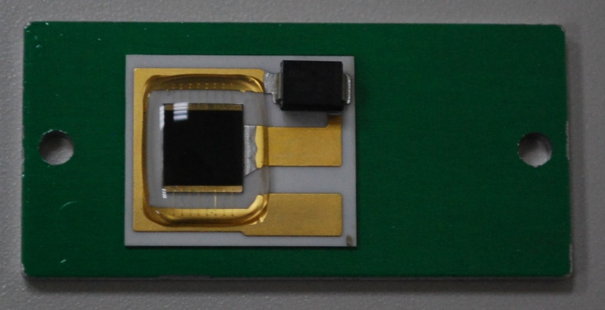
Production
Ingots: 4” 1000 kg, 6” 500 kg
Wafers: EPI ready 4” 120,000
Submounts:
  5.5x5.5 mm 1.2 million
  7x7 mm 120,000
  10x10 mm 120,000

Slide 15
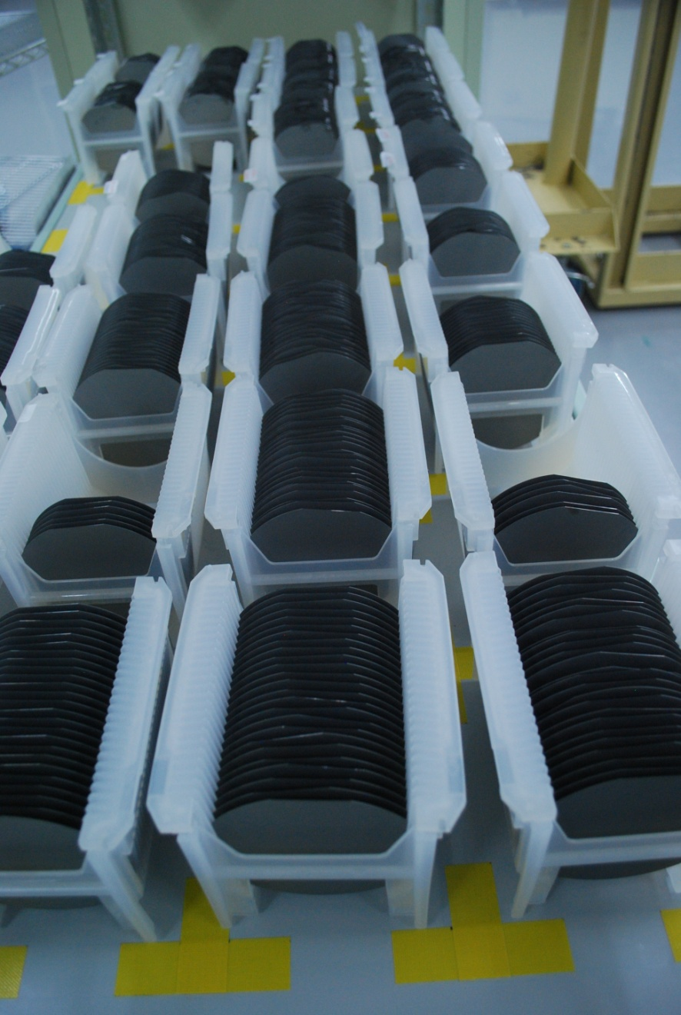
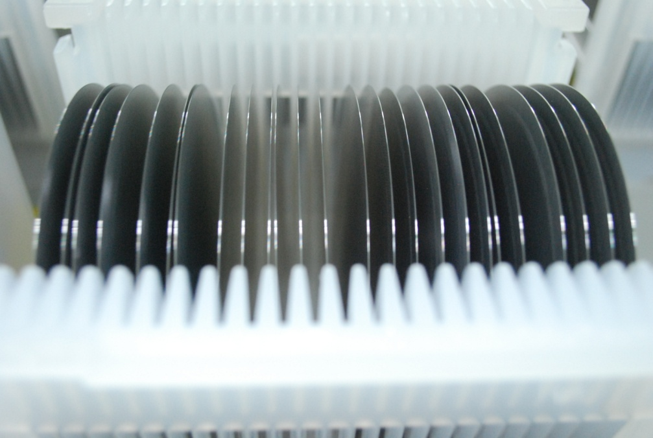
TaiCrystal Wafers

Slide 16
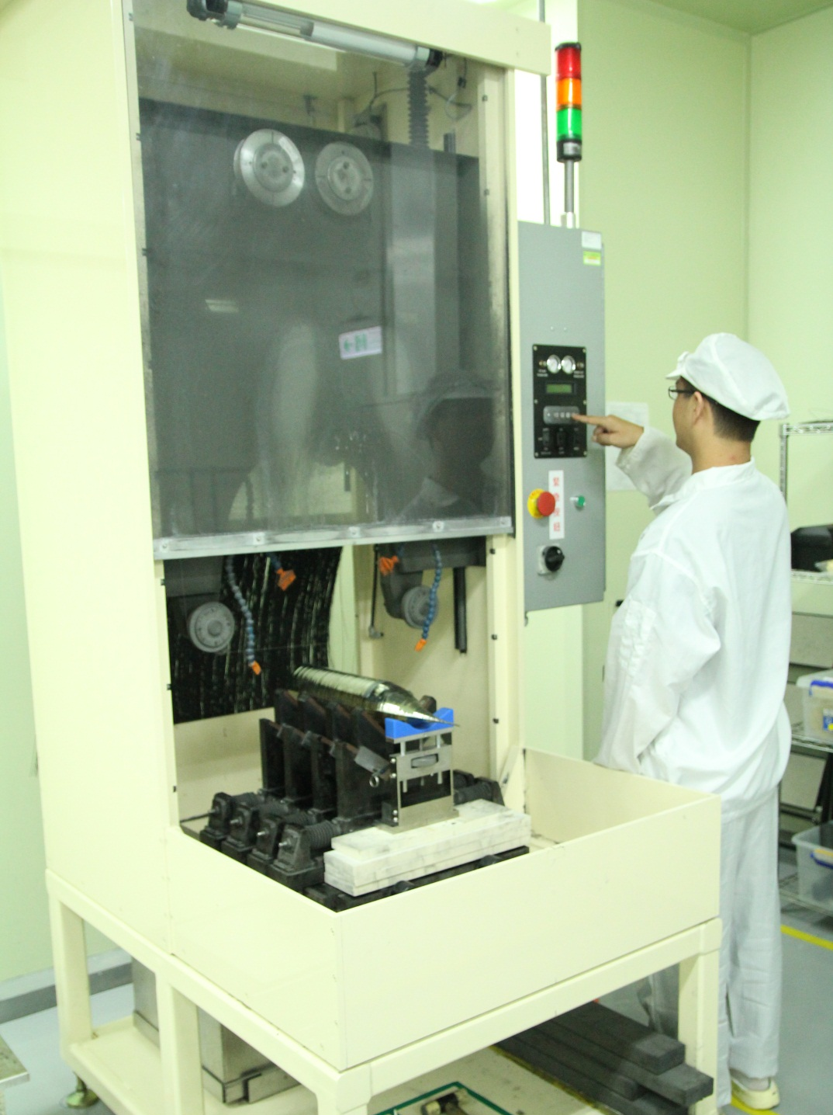
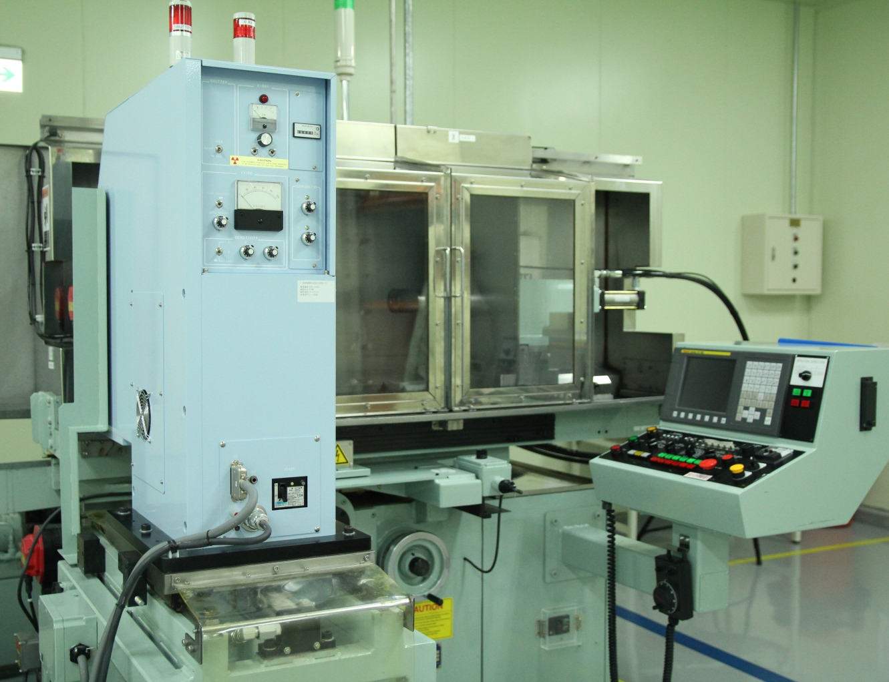
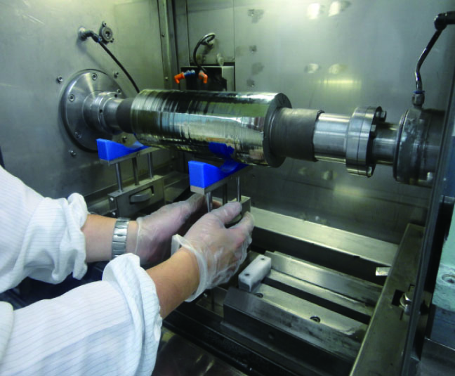
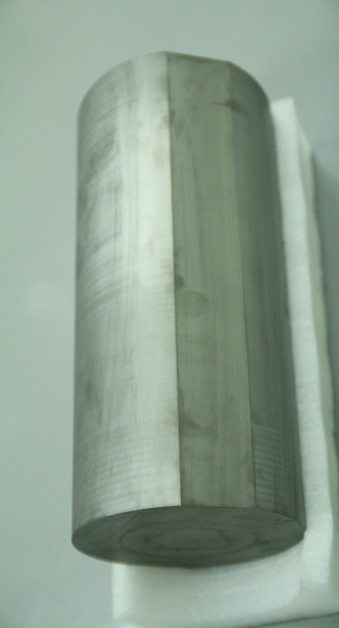
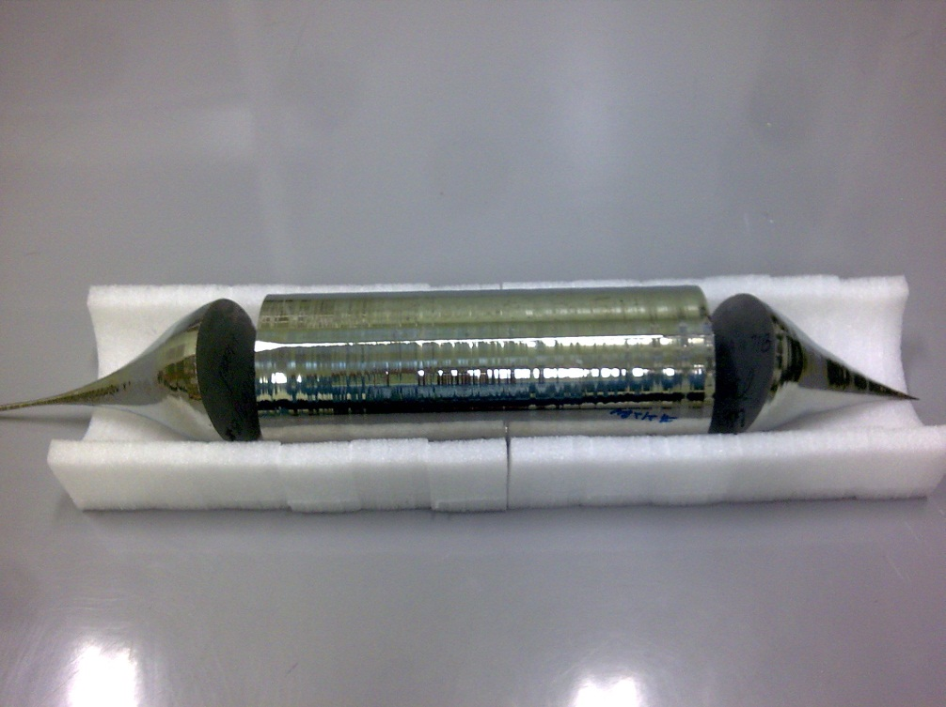
Ge INGOT
Ingot Rounding
Ingot Cropping
after rounding
crown
body
tail
after cropping

Slide 17
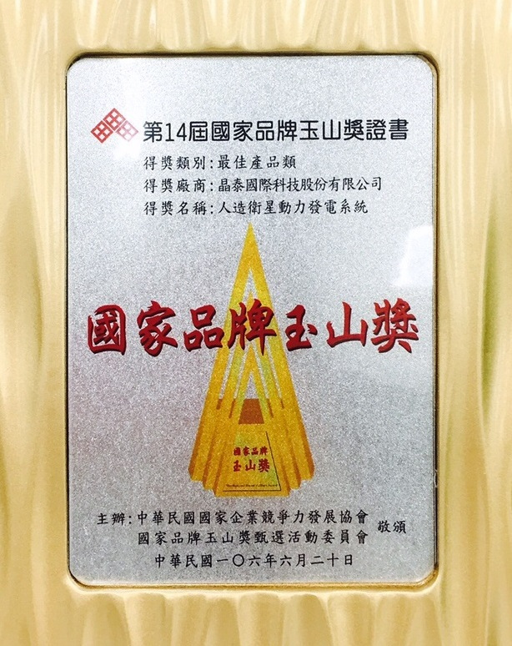

2017 Taiwan National Brand Award
Best Product
With TaiCrystal Ge wafer, solar cells had been used on UAVs and satellites.
The R&D abilities of TaiCrystal have been recognized by the award committee of Taiwan.

Slide 18
ISO

